Slide 1



Chocolate Sales Performance Analysis
Using Power BI to uncover trends, regional patterns, and revenue insights
PRESENTED BY: RIYA SIDHU
Notes:
1

Slide 2


Problem Statement
A chocolate company seeks to analyze sales performance across products, regions, salespersons, and time — identifying key trends and revenue patterns to drive smarter business decisions.
📊 Product Performance
Identify top-selling categories and revenue contributors
🌍 Regional Analysis
Compare sales across regions and countries
👤 Salesperson Insights
Evaluate individual contribution to overall revenue
📅 Time Trends
Uncover monthly and seasonal demand patterns
Notes:
2

Slide 3
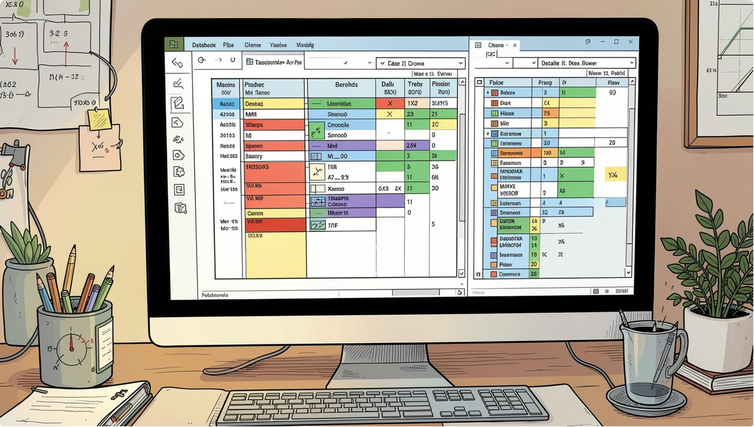
Dataset Overview
Chocolate Sales Dataset
Four interconnected tables form the foundation of this analysis:
Products
Category, pricing, and product details
Shipments
Boxes shipped, ship dates, and volumes
Geography
Region and country-level data
Sales Person
Salesperson names and assignments
Key Columns: Product Category · Amount · Boxes · Ship Date · Region · Salesperson
Notes:
3

Slide 4

Data Cleaning & Preparation
Data was cleaned using Google Colab and Power BI to ensure accuracy and reliability before analysis.
Check Missing
Remove Duplicates
Verify Types
The dataset passed all quality checks — no missing values, no duplicate records, and all data types verified. The clean dataset was ready for Power BI modelling and visualisation.
Notes:
4

Slide 5
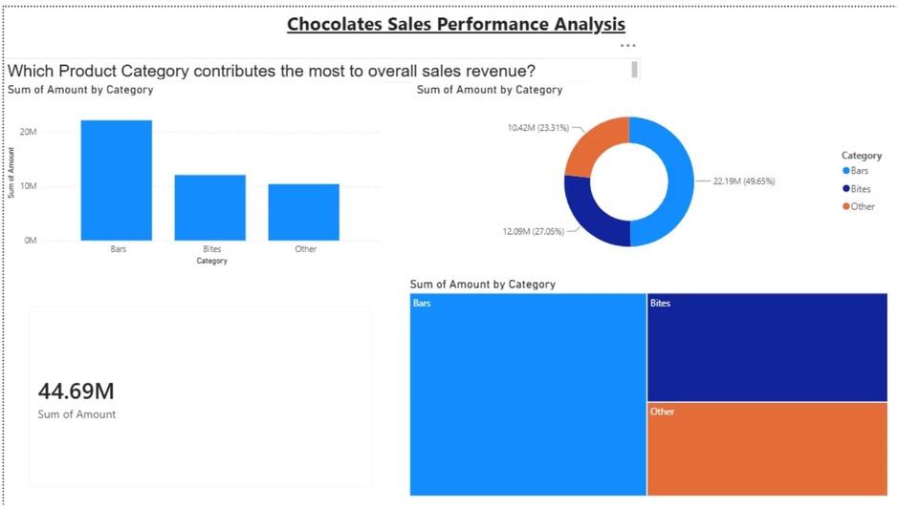
QUESTION 1
Which product category contributes the most to overall sales revenue?
Key Insight
Bars emerged as the highest revenue-generating product category, significantly outpacing Truffles, Pralines, and Gift Boxes.
Bars dominate overall sales contribution
Gift Boxes and Spreads show lower but steady revenue
Category-level focus can guide inventory and marketing
Notes:
5

Slide 6
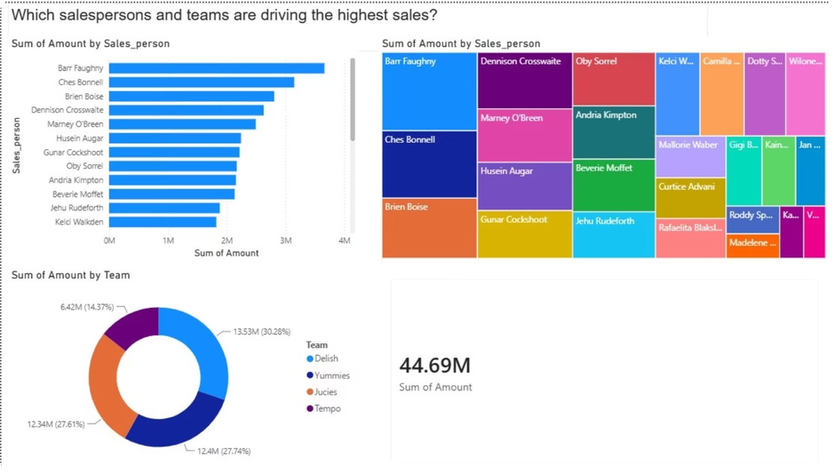
QUESTION 2
Which Salespersons and teams are driving the Highest sales?
Salesperson Performance
Revenue contribution varies significantly across the sales team. Identifying top performers helps recognise excellence and set benchmarks.
Top salespersons drive a large share of total revenue
Performance gaps reveal coaching opportunities
Individual targets can be calibrated based on data
Notes:
6

Slide 7
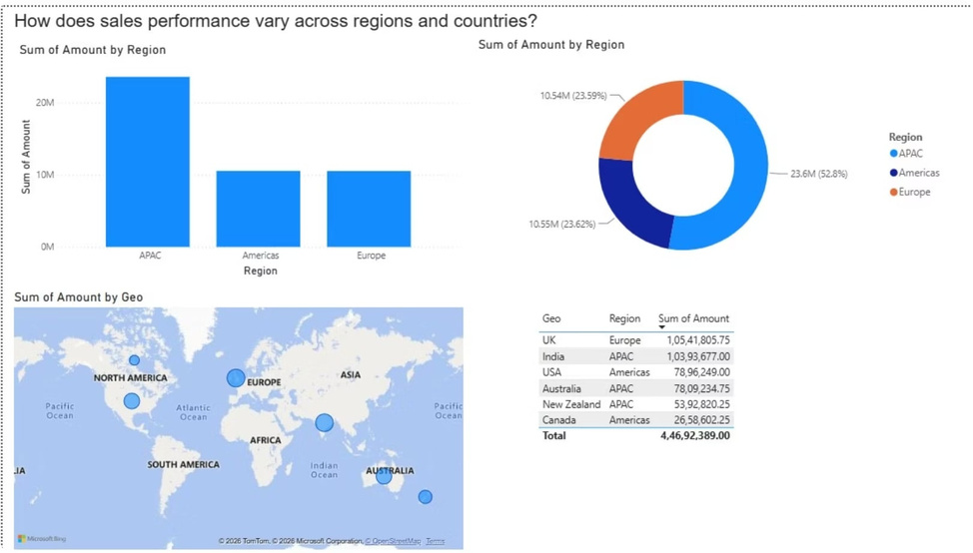
QUESTION 3
How Does Sales Performance Vary Across Regions and countries?
Regional Insights
Sales differ markedly across regions, with certain countries generating significantly higher revenue than others.
North region leads in total revenue contribution
Specific countries within regions show standout performance
Underperforming regions represent growth opportunities
Regional strategy should be tailored to local demand
Notes:
7

Slide 8
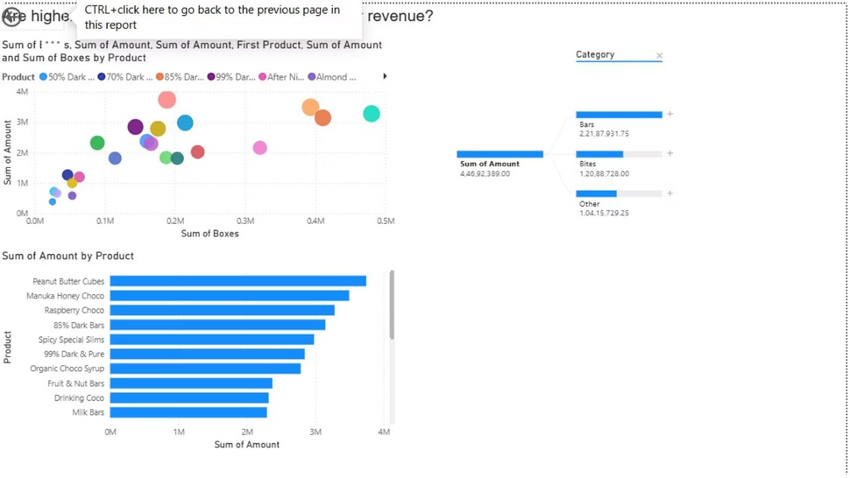
QUESTION 4
Do Higher Shipments Always Mean Higher Revenue?
Key Finding
Higher shipment volumes do not always translate to higher revenue. Product value and pricing play an equally critical role.
Truffles: fewer boxes, but high per-unit value
Spreads: high volume, but lower revenue per box
Revenue optimisation requires balancing volume and value
Notes:
8

Slide 9
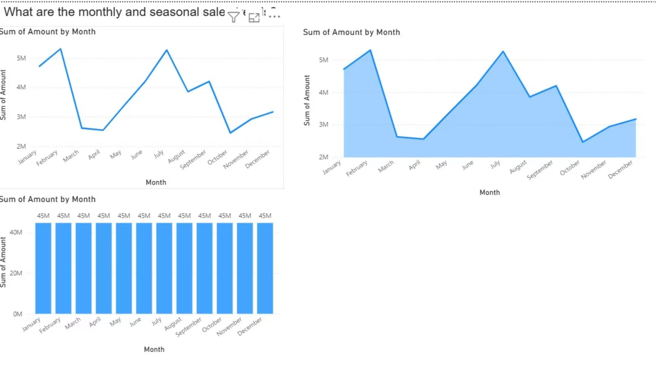
What Are the Monthly and Seasonal Sales Trends?
Sales fluctuate throughout the year, with a clear upward trend towards Q4 — indicating strong seasonal demand during festive periods. Peak revenue occurs in November and December, likely driven by holiday gifting. This pattern can inform inventory planning and promotional campaigns
.
Notes:
9

Slide 10

Key Findings & Conclusion
🍫 Top Category
🏆 Best Salesperson
🌐 Regional Gaps
Bars lead revenue across all product categories
Top performers identified for recognition and benchmarking
North region dominates; others hold growth potential
📦 Volume ≠ Revenue
📅 Seasonal Peaks
Product value matters as much as shipment volume
Q4 shows strongest demand — plan inventory accordingly
Conclusion: Power BI dashboards delivered actionable insights into product, regional, and employee performance — enabling data-driven decisions to strengthen sales strategy.
Thank You
Notes:
10

